Slide 1
NEO4J CYPHER TUTORIAL WITH PYTHON
Distinct Operator
Tutorial 57

Slide 2
Distinct Operator
Definition
The aggregation operators comprise: • remove duplicates values: DISTINCT

Slide 3
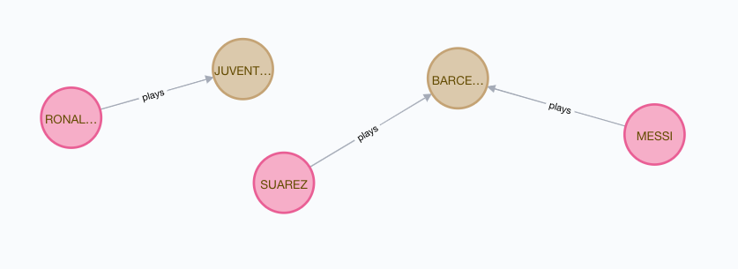
Distinct operator
Example Graph

Slide 4
Distinct operator
Example Graph code
create (a:PLAYER{NAME:"MESSI"}),(b:PLAYER{NAME:"SUAREZ"}),(C:PLAYER{NAME:"RONALDO"})
create (a:team{NAME:"BARCELONA"}),(b:team{NAME:"JUVENTAS"})
MATCH (A:PLAYER{NAME:"MESSI"}),(B:team{NAME:"BARCELONA"})
CREATE (A)-[R1:plays]->[B]
MATCH (A:PLAYER{NAME:“SUAREZ"}),(B:team{NAME:"BARCELONA"})
CREATE (A)-[R1:plays]->[B]
MATCH (A:PLAYER{NAME:“RONALDO"}),(B:team{NAME:“JUVENTAS"})
CREATE (A)-[R1:plays]->[B]

Slide 5
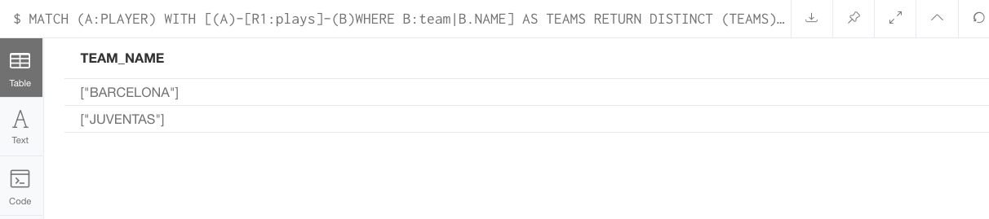
Distinct Operator
FIND THE DISTINCT TEAMS
MATCH (A:PLAYER)
WITH [(A)-[R1:plays]-(B)WHERE B:team|B.NAME] AS TEAMS
RETURN DISTINCT (TEAMS) AS TEAM_NAME
IT WILL RETURN THE BELOW

Slide 6
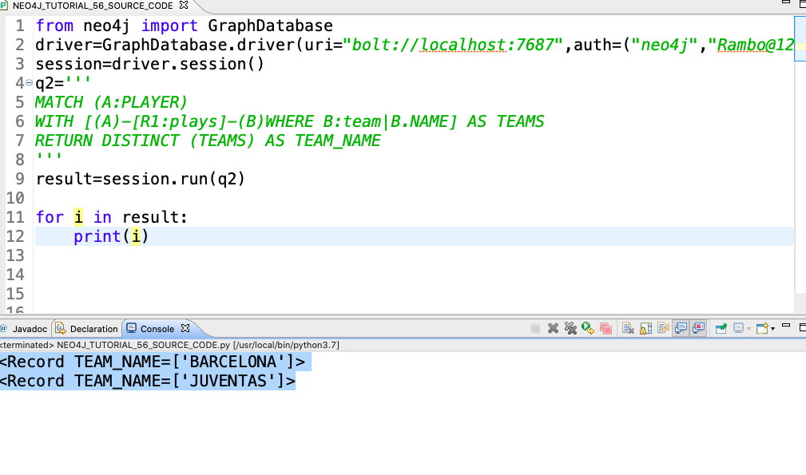
Distinct Operator
FIND THE DISTINCT TEAMS

